Slide 1
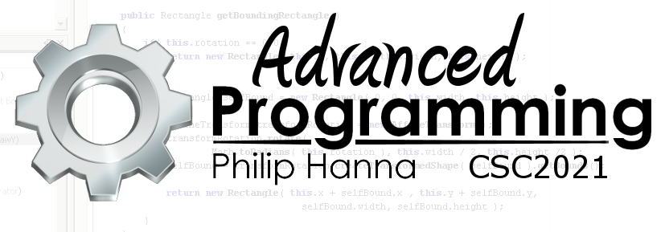
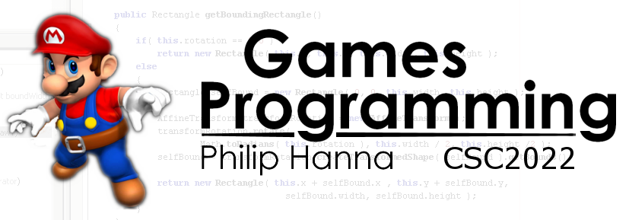
Game Input
Getting user input into your game

Slide 2
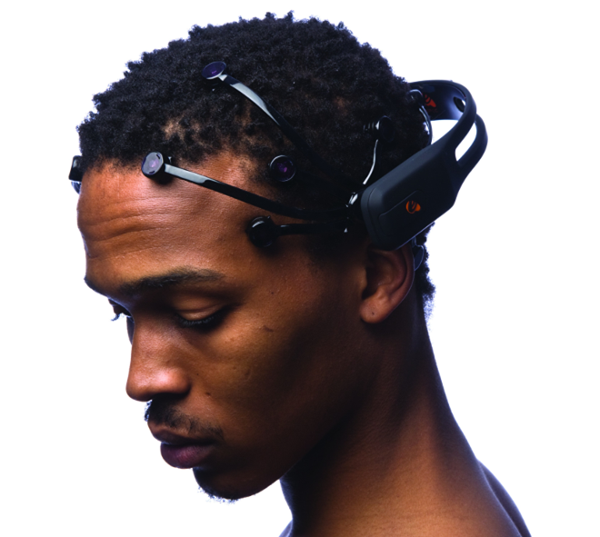
Sources
of
Input

Slide 3
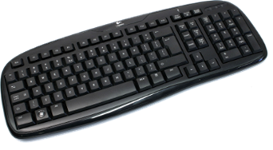
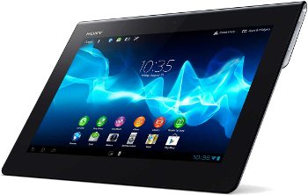
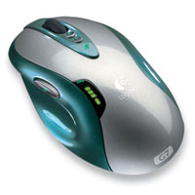
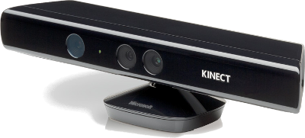
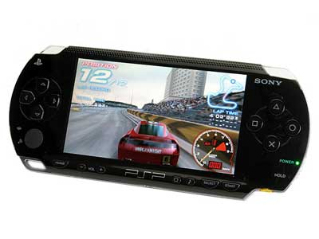
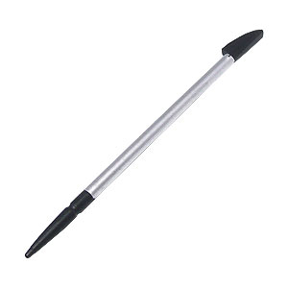
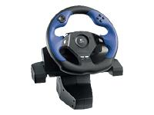
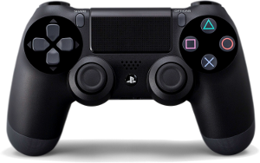
There are a wide range of different devices used to provide input into games.
Devices tend to provide different usability profiles and will differ in terms of their suitability to some types of game.
A game should best exploit the various input devices it is designed to run with.

Slide 4
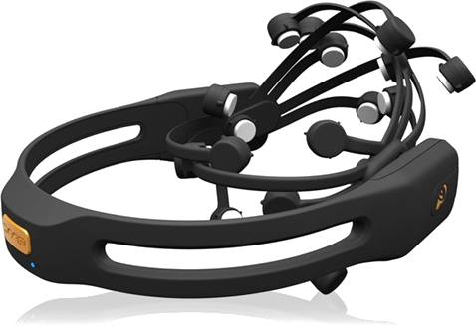


Input devices need not restrict themselves to the press of a finger or movement of some stick (e.g. touch screen, gamepad, driving wheel, joystick). Novel forms of interface can include:
Bioelectrical input
Speech input
Emotion/thought recognition
Bit of fun: You have 5 minutes to come up with an interesting form of gameplay for any of these novel forms of interface.
Start
5 mins
4 mins
3 mins
2 mins
1 min
30 sec
Finished

Slide 5
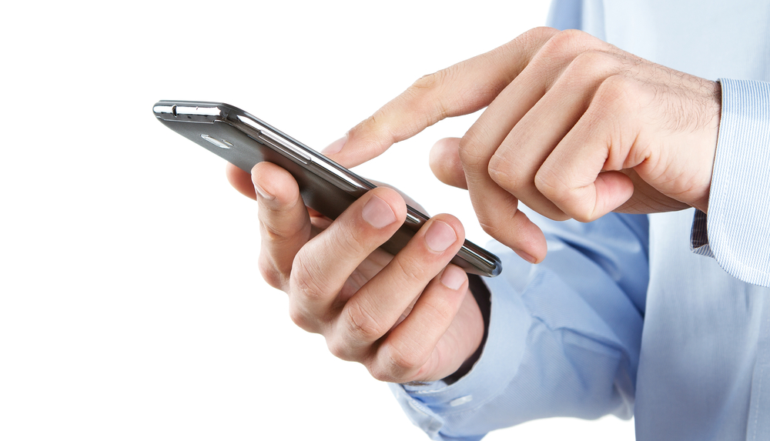
Mobile
Device
Input

Slide 6
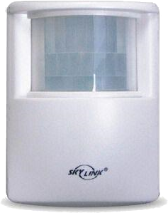
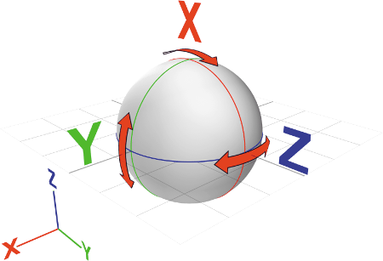

Current mobile devices may have the following:
Motion sensors: Measuring forces including accelerometers, gravity sensors and gyroscopes.
Environmental sensors: Measuring environmental parameters including air temperature, air pressure, illumination, and humidity.
Position sensors: Measuring the physical position of the device, including orientation sensors and magnetometers.

Slide 7
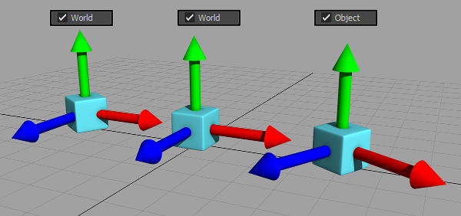
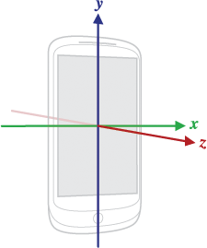
A number of sensors (including acceleration, gravity and the gyroscope) use a 3-axis coordinate system [x,y,z].
The coordinate system is defined relative to the device's default orientation (X-axis points to the right; Y-axis points up; Z-axis points out from the screen). Note: the natural (default) orientation may be either portrait or landscape.
Importantly: The coordinate system is fixed and does not change as the device moves (e.g. the axes do not swap when the screen orientation changes).
Aside: See the following for a solution
http://android-developers.blogspot.co.uk/2010/09/one-screen-turn-deserves-another.html

Slide 8

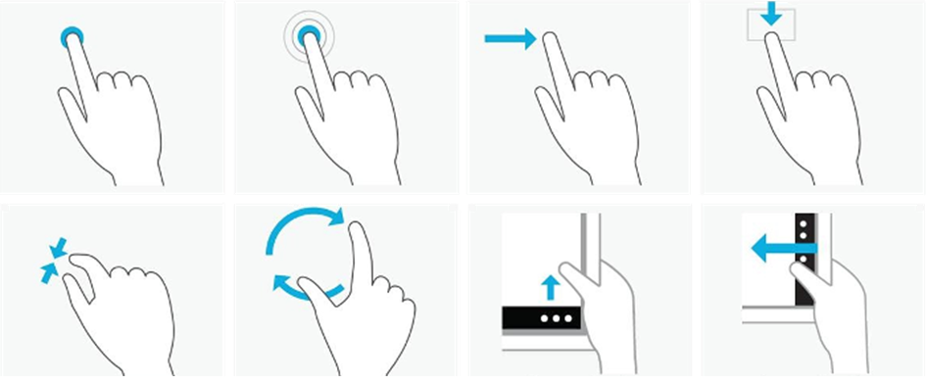
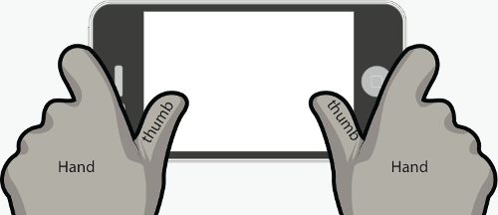
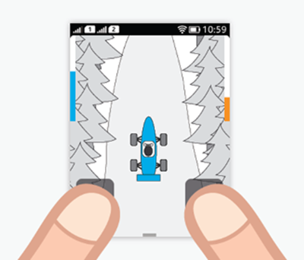
A set of common gestures are used in touch interfaces.
If a game has continuous input the UI must be designed such that:
Input can be easily provided
Key information is clearly visible
The device can be comfortably held.
To do:
Consider for your own game
http://gesturecons.com/

Slide 9
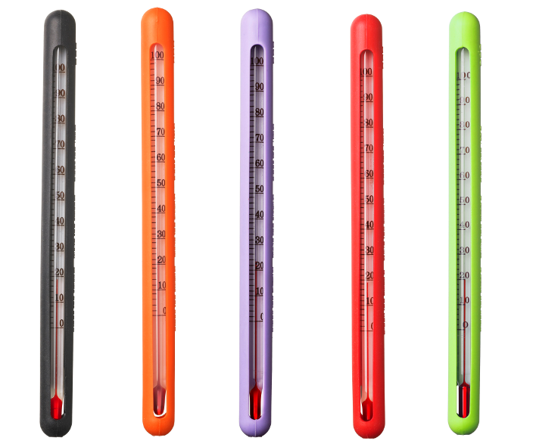
Design challenge:
Design a fun game in which the primary form of input is from the device’s temperature sensor.
Start
10 mins
9 mins
8 mins
7 mins
6 mins
5 mins
4 mins
3 mins
2 mins
1 min
30 sec
Finished

Slide 10
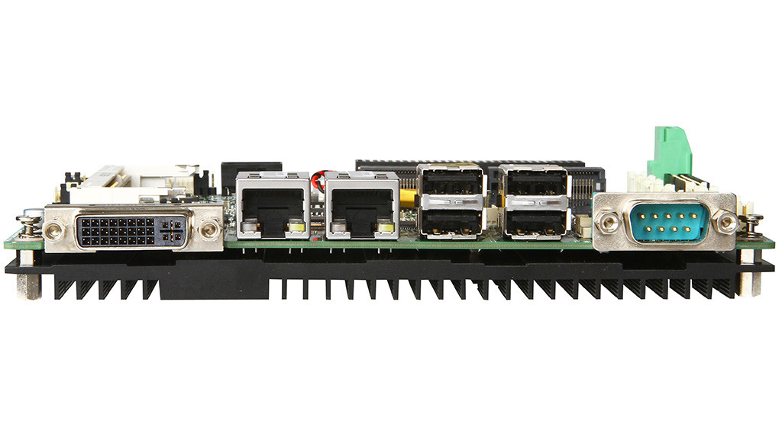
Game Input Mechanisms
Event driven input vs. input polling

Slide 11
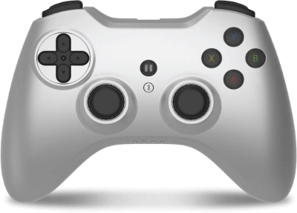
Event Handler
Event
Event
Event
Event-driven input assumes that one, or more, event handlers will handle certain event types.
Given an input event, the designated call-back event handler is called, consuming the event and taking whatever action is needed.
In contrast, input polling works by getting the state of the input device at regular intervals and checking for change. Most games use input polling.
Poll Device
Poll Device
Poll Device
Poll Device

Slide 12


: Advantages and Disadvantages
+
Low level of control, fits well with the frequent update-draw loop in games
Input polling provides a snap-shot at an instant in time. Events occurring over a period of time must be inferred from changes in the snap-shots.
This includes ‘basic’ events such as a typed key or more sophisticated events such as a mouse drag.
_
State Up Up Down Down Down Down Up
Time 15ms 30ms 45ms 60ms 75ms 90ms 105ms
▲Pressed ▲Released+Typed

Slide 13

: Introductory Pitfalls
1 | update() {
2 | if (launchKeyPressed)
3 | launchProjectile();
4 | }
At 60 updates per second, there are some things you do not want to do every update (and maybe only twice per second)
Sometimes you might only want to do something once an animation has finished playing:
In general:
1 | update() {
2 | if (input_event_detected)
3 | if (event_execution_requirements_passed)
4 | executeEvent();
5 | }

Slide 14


: Decoupled Input
1 | update() {
2 | considerInput(); }
3
4 | considerInput() {
5 | if (‘A’ button pressed)
6 | doAction();
7 | }
Many games support multiple input devices and/or user configurable controls.
In such games it is advantageous to decouple input from input event checking.
Decoupling enables input mapping logic to be separated from the code that responds to input events.
More generally, decoupling helps promote software extensibility and reusability.
1 | update() {
2 | checkForInput();
3 | considerInput();
4 | }
5
6 | checkForInput() {
7 | if (‘A’ button or ‘J’ key)
8 | jumpInputEvent = true; }
9
10 | considerInput() {
11 | if (jumpInputEvent)
12 | doAction(); }

Slide 15

Key takeaways:
Tablets and smartphones can support a wide variety of different forms of input.
Most games use input pooling within the update loop to detect changes in the state of input devices.

